Slide 1
Cache Tutorial 1

Slide 2
Cache Block Concepts
1) For a 32KB direct mapped cache with 64 byte cache block, give the address of the starting byte of the first word in the block that contains the address 0X 7245E824.

Slide 3
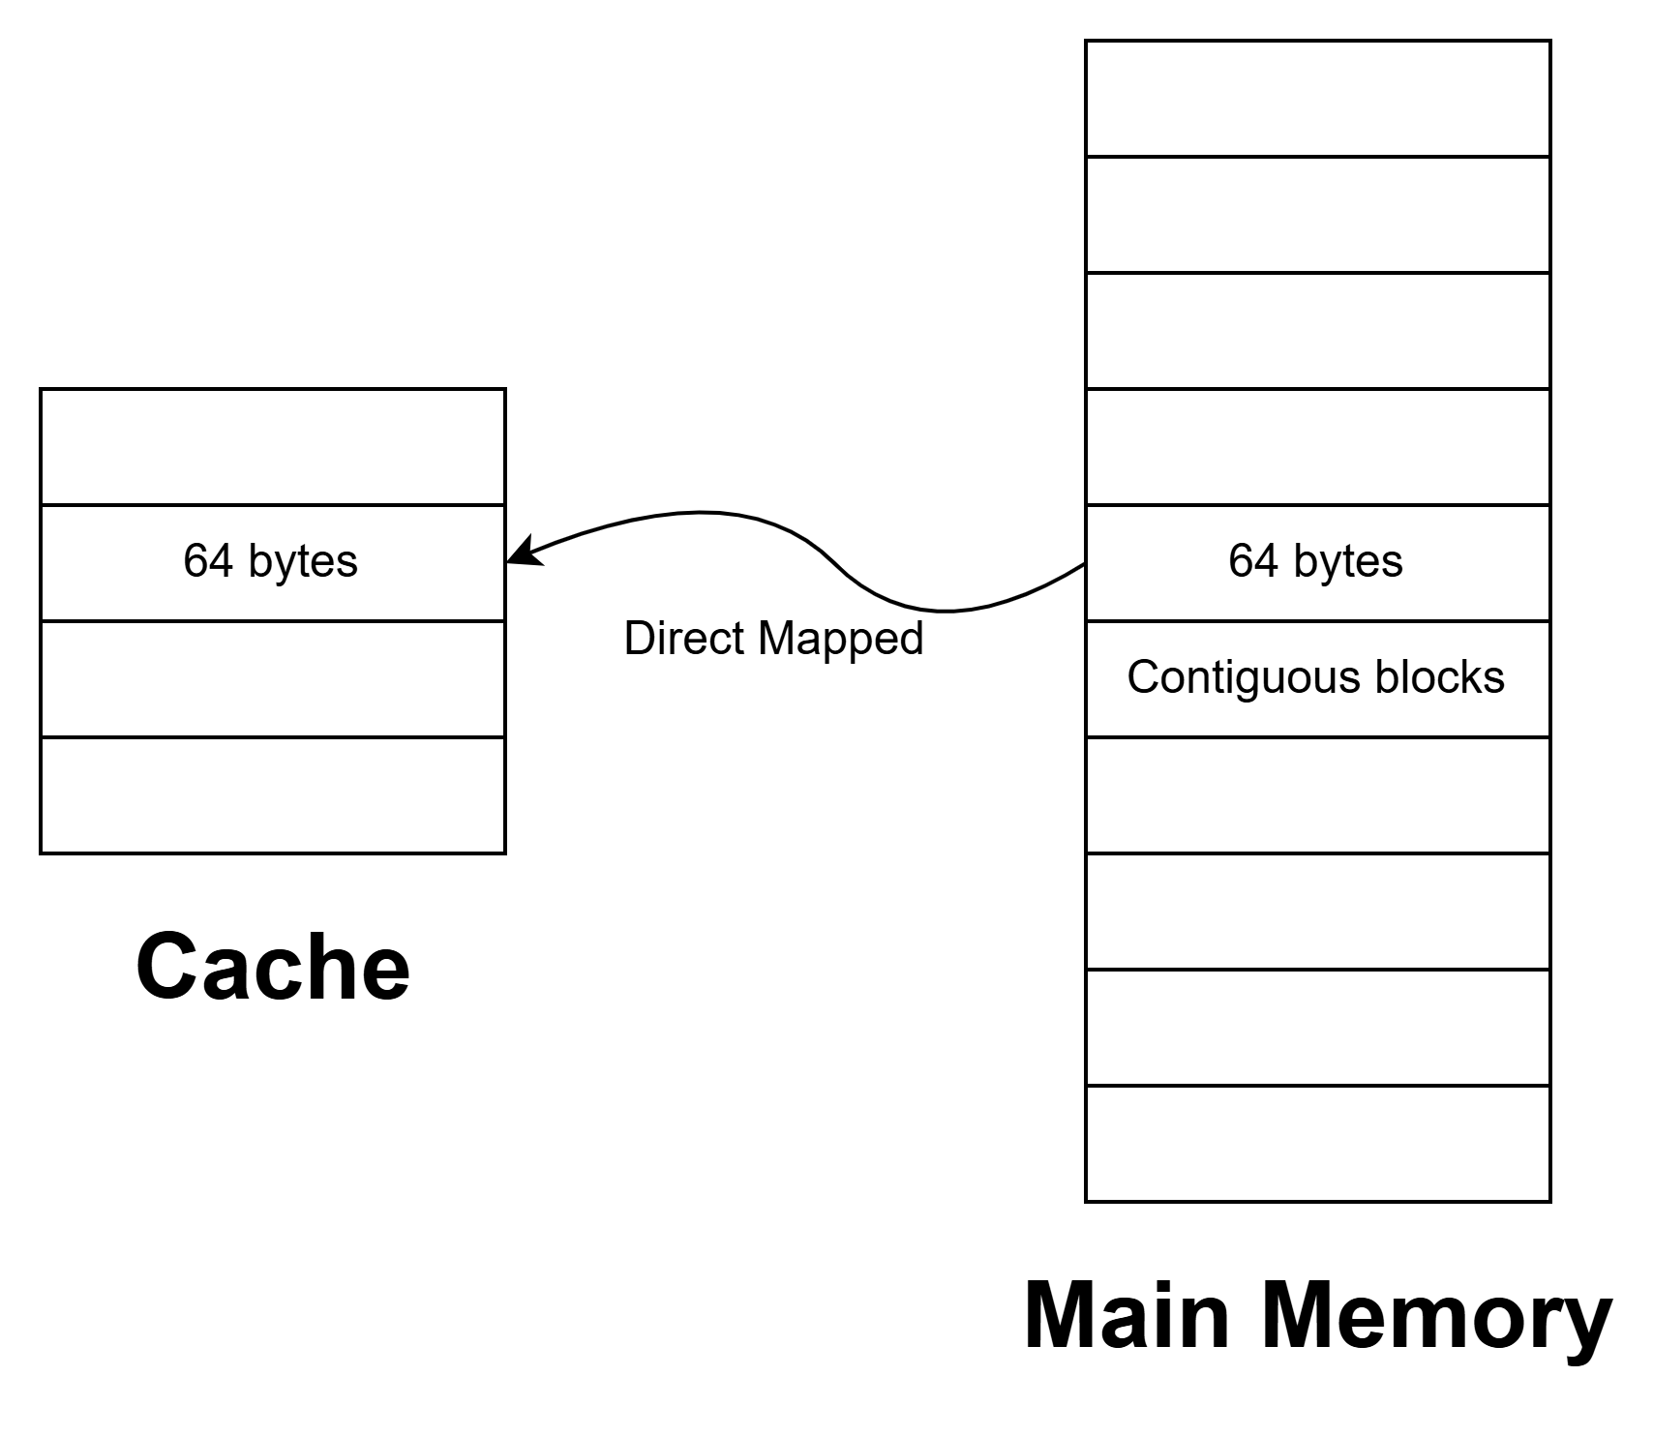
Cache Block Concepts
1) For a 32KB direct mapped cache with 64 byte cache block, give the address of the starting byte of the first word in the block that contains the address 0X 7245E824.

Slide 4
Cache Block Concepts
1) For a 32KB direct mapped cache with 64 byte cache block, give the address of the starting byte of the first word in the block that contains the address 0X 7245E824.
Words in a cache block differ only in few least significant bits
The remaining bits that is most significant bits stays same.

Slide 5
Cache Block Concepts
1) For a 32KB direct mapped cache with 64 byte cache block, give the address of the starting byte of the first word in the block that contains the address 0X 7245E824.
32KB direct mapped cache with 64 byte cache block address 0X 7245E824.
# sets = Cache Size/(Block Size x A) = 2¹⁵/(2⁶ x 1) = 2⁹ = 512 sets
Address: 0x 7245E824 --------0010 0100 offset (6 bits)
Block address range from ______ 0000 0000 to _____ 0011 1111 0x 7245E800 to 0x 7245E83F.
Hence starting address is 0x 7245E800
Tag ? | Index = 9 | Offset = 6

Slide 6
Index and Offset Calculations
2) A cache has 512 KB capacity, 4B word, 64B block size and 8-way set associative. The system is using 32 bit address. Given the following addresses, which set of cache will be searched and specify which word of the selected cache block will be forwarded if it is a hit in cache?
(a) 0X ABC89984 (b) 0X 485669AC

Slide 7
Index and Offset Calculations
2) A cache has 512 KB capacity, 4B word, 64B block size and 8-way set associative. The system is using 32 bit address. Given the following addresses, which set of cache will be searched and specify which word of the selected cache block will be forwarded if it is a hit in cache?
(a) 0X ABC89984 (b) 0X 485669AC
# sets = Cache Size/(Block Size x A) = 2¹⁹/(2⁶x2³) = 2¹⁰ = 1024 sets
1 word = 4B, Hence 64 byte block has 16 words
Note: Offset = 6 means…1 block = 16 words, 1 word = 4 bytes. To address each byte in a word, we need 2 LSBs. And to address each word in a block we need the rest 4 MSBs.
0x ABC89984 = 1001 1001 1000 0100 Set 614, word 1
0x 485669AC = 0110 1001 1010 1100 Set 422, word 11
In Set 614, we match tag bits in all the 8 cache lines (8-way associative), whichever tag matches we transfer that word from the block.
Tag = 16 | Index = 10 | Offset = 6 (4 + 2)

Slide 8
Tag and Data array Access
3) It takes 3 ns to access a tag array value and 4.2 ns to access a data array, 1.3 ns to perform hit/ miss comparison and 1ns to return the selected data to processor.
What is the cache hit latency of the system?
What is the cache hit latency of the system if hit/ miss comparison will take 0.6 ns?
What would be the hit latency if both tag and data array access take 3.5 ns and hit/ miss comparison take 1 ns?

Slide 9
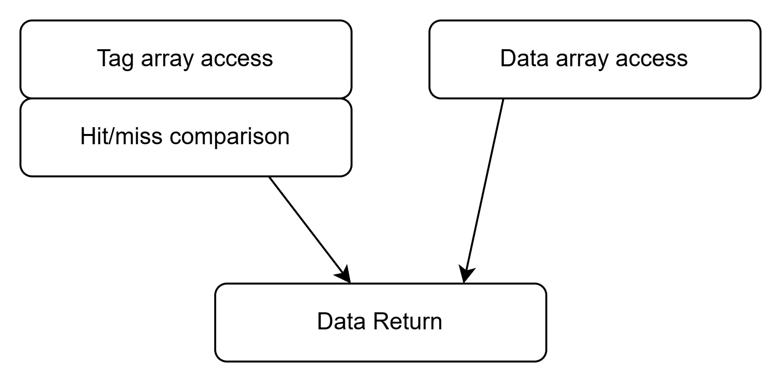
Tag and Data array Access
3) It takes 3 ns to access a tag array value and 4.2 ns to access a data array, 1.3 ns to perform hit/ miss comparison and 1ns to return the selected data to processor.
What is the cache hit latency of the system?
What is the cache hit latency of the system if hit/ miss comparison will take 0.6 ns?
What would be the hit latency if both tag and data array access take 3.5 ns and hit/ miss comparison take 1 ns?

Slide 10
Tag and Data array Access
3) It takes 3 ns to access a tag array value and 4.2 ns to access a data array, 1.3 ns to perform hit/ miss comparison and 1ns to return the selected data to processor.
What is the cache hit latency of the system?
What is the cache hit latency of the system if hit/ miss comparison will take 0.6 ns?
What would be the hit latency if both tag and data array access take 3.5 ns and hit/ miss comparison take 1 ns?
Max (3+1.3, 4.2) + 1 =5.3ns

Slide 11
Tag and Data array Access
3) It takes 3 ns to access a tag array value and 4.2 ns to access a data array, 1.3 ns to perform hit/ miss comparison and 1ns to return the selected data to processor.
What is the cache hit latency of the system?
What is the cache hit latency of the system if hit/ miss comparison will take 0.6 ns?
What would be the hit latency if both tag and data array access take 3.5 ns and hit/ miss comparison take 1 ns?
Max (3+1.3, 4.2) + 1 =5.3ns
Max (3+0.6, 4.2) + 1 =5.2ns

Slide 12
Tag and Data array Access
3) It takes 3 ns to access a tag array value and 4.2 ns to access a data array, 1.3 ns to perform hit/ miss comparison and 1ns to return the selected data to processor.
What is the cache hit latency of the system?
What is the cache hit latency of the system if hit/ miss comparison will take 0.6 ns?
What would be the hit latency if both tag and data array access take 3.5 ns and hit/ miss comparison take 1 ns?
Max (3+1.3, 4.2) + 1 =5.3ns
Max (3+0.6, 4.2) + 1 =5.2ns
Max (3.5+1, 3.5) + 1 =5.5ns

Slide 13
MPKI – Miss rate Relation
4) The MPKI of a two programs A and B are 44 and 35 respectively. If 35% of A is data access instruction, what is the data access pattern of B if both A and B have same cache hit rate?

Slide 14
MPKI – Miss rate Relation
4) The MPKI of a two programs A and B are 44 and 35 respectively. If 35% of A is data access instruction, what is the data access pattern of B if both A and B have same cache hit rate?
MPKI-A = 44 ; MPKI-B=35
Hit Rate A = Hit Rate B => Miss Rate A = Miss Rate B
MR = misses/ memory access
(misses/ instruction) / (memory access / instruction)
MR= MPI/MAPI
Given that Miss Rate A = Miss Rate B => (44/1000)/1.35 = (35/1000)/ MAPI-B
MAPI-B= (0.035x1.35)/0.044 = 1.073
7.3% of instructions in B are data access instructions

Slide 15
Block Replacement Algorithms
5) Consider a 4-way associative cache that can be operated in one among the two modes at a time. In mode-1 it uses pseudo LRU block replacement policy and in mode-2 it uses Last In First Out block replacement policy. Assume all the cache blocks are initially empty and filling up of empty blocks in a given cache set happens from way 0 to way-3. Consider the following 14 block numbers all mapped to a particular set n given in the order of arrival.
A, B, C, D, A, B, E, F, A, B, F, C, D, A.
Find the number of cache misses (excluding compulsory misses) in mode-1.
Draw the pseudo LRU tree for set n after processing these requests in mode-1.
Find the number of cache misses (including compulsory misses) in mode-2.
Draw the content of set n (way-0 to way-3) after processing these requests in mode-2.

Slide 16
Block Replacement Algorithms
5) Consider a 4-way associative cache that can be operated in one among the two modes at a time. In mode-1 it uses pseudo LRU block replacement policy and in mode-2 it uses Last In First Out block replacement policy. Assume all the cache blocks are initially empty and filling up of empty blocks in a given cache set happens from way 0 to way-3.
All the cache blocks are initially empty and filling up of empty blocks in a given cache set happens from way 0 to way-3. pseudo LRU block replacement policy Block List that maps to set n. A, B, C, D, A, B, E, F, A, B, F, C, D, A.

Slide 17
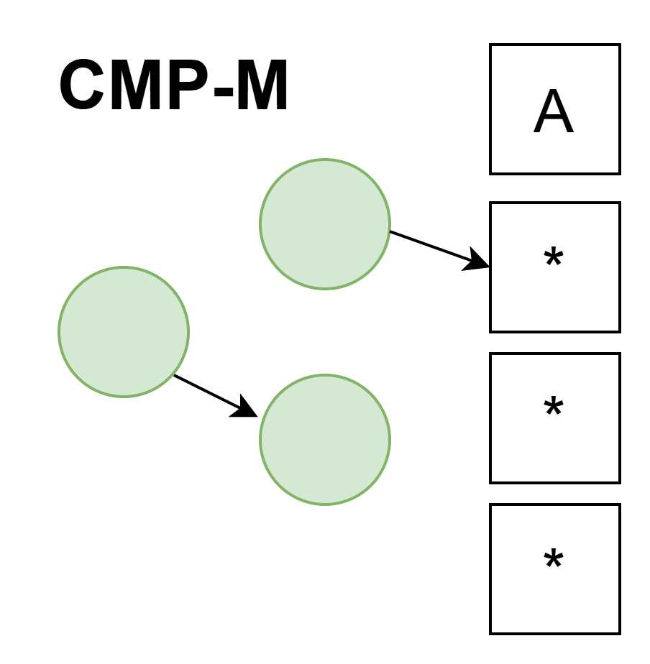
Block Replacement Algorithms
5) Consider a 4-way associative cache that can be operated in one among the two modes at a time. In mode-1 it uses pseudo LRU block replacement policy and in mode-2 it uses Last In First Out block replacement policy. Assume all the cache blocks are initially empty and filling up of empty blocks in a given cache set happens from way 0 to way-3.
All the cache blocks are initially empty and filling up of empty blocks in a given cache set happens from way 0 to way-3. pseudo LRU block replacement policy Block List that maps to set n. A, B, C, D, A, B, E, F, A, B, F, C, D, A.

Slide 18
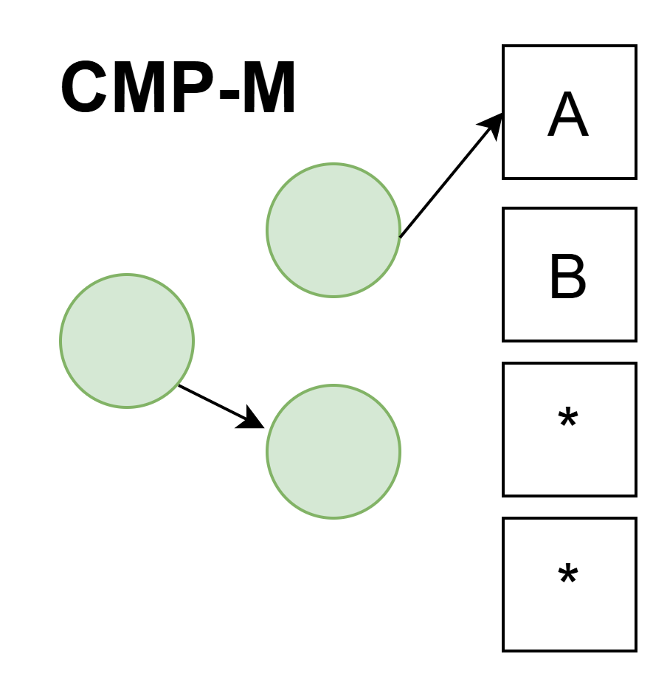
Block Replacement Algorithms
5) Consider a 4-way associative cache that can be operated in one among the two modes at a time. In mode-1 it uses pseudo LRU block replacement policy and in mode-2 it uses Last In First Out block replacement policy. Assume all the cache blocks are initially empty and filling up of empty blocks in a given cache set happens from way 0 to way-3.
All the cache blocks are initially empty and filling up of empty blocks in a given cache set happens from way 0 to way-3. pseudo LRU block replacement policy Block List that maps to set n. A, B, C, D, A, B, E, F, A, B, F, C, D, A.

Slide 19
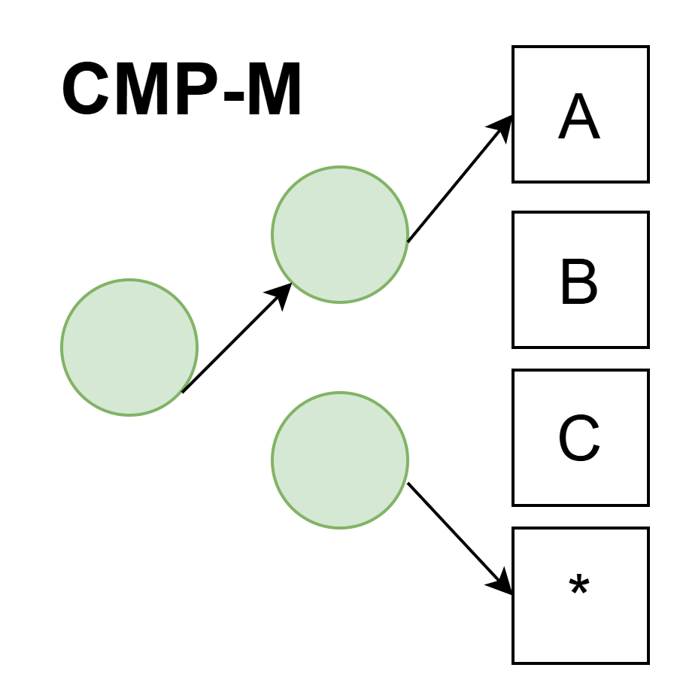
Block Replacement Algorithms
5) Consider a 4-way associative cache that can be operated in one among the two modes at a time. In mode-1 it uses pseudo LRU block replacement policy and in mode-2 it uses Last In First Out block replacement policy. Assume all the cache blocks are initially empty and filling up of empty blocks in a given cache set happens from way 0 to way-3.
All the cache blocks are initially empty and filling up of empty blocks in a given cache set happens from way 0 to way-3. pseudo LRU block replacement policy Block List that maps to set n. A, B, C, D, A, B, E, F, A, B, F, C, D, A.

Slide 20
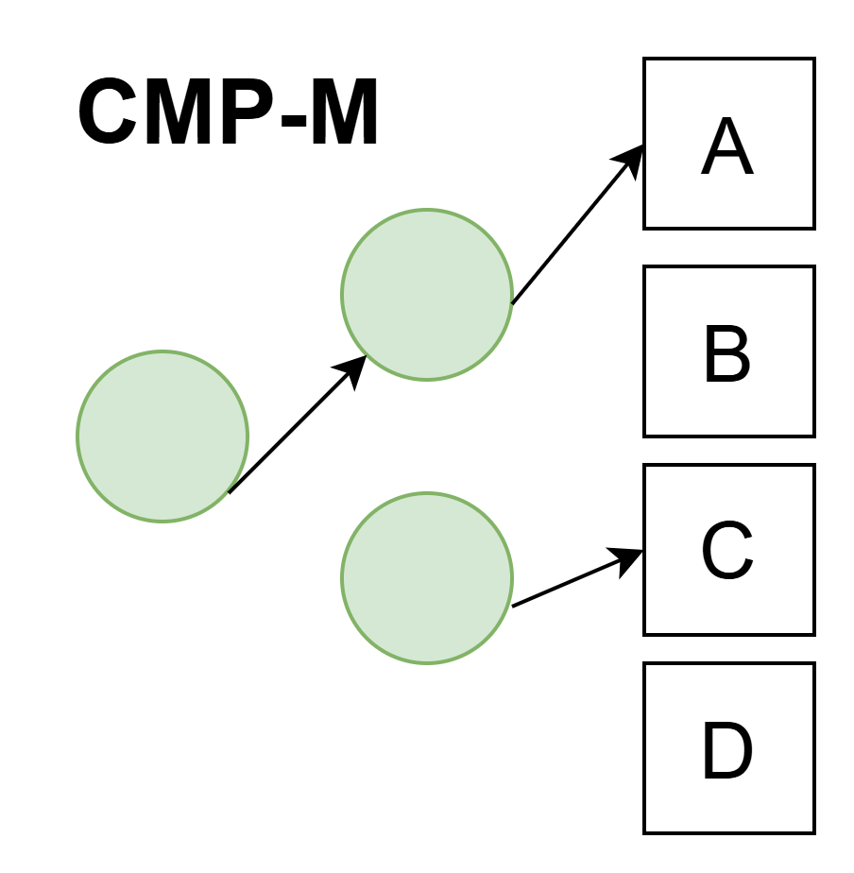
Block Replacement Algorithms
5) Consider a 4-way associative cache that can be operated in one among the two modes at a time. In mode-1 it uses pseudo LRU block replacement policy and in mode-2 it uses Last In First Out block replacement policy. Assume all the cache blocks are initially empty and filling up of empty blocks in a given cache set happens from way 0 to way-3.
All the cache blocks are initially empty and filling up of empty blocks in a given cache set happens from way 0 to way-3. pseudo LRU block replacement policy Block List that maps to set n. A, B, C, D, A, B, E, F, A, B, F, C, D, A.

Slide 21

Block Replacement Algorithms
5) Consider a 4-way associative cache that can be operated in one among the two modes at a time. In mode-1 it uses pseudo LRU block replacement policy and in mode-2 it uses Last In First Out block replacement policy. Assume all the cache blocks are initially empty and filling up of empty blocks in a given cache set happens from way 0 to way-3.
All the cache blocks are initially empty and filling up of empty blocks in a given cache set happens from way 0 to way-3. pseudo LRU block replacement policy Block List that maps to set n. A, B, C, D, A, B, E, F, A, B, F, C, D, A.

Slide 22

Block Replacement Algorithms
5) Consider a 4-way associative cache that can be operated in one among the two modes at a time. In mode-1 it uses pseudo LRU block replacement policy and in mode-2 it uses Last In First Out block replacement policy. Assume all the cache blocks are initially empty and filling up of empty blocks in a given cache set happens from way 0 to way-3.
All the cache blocks are initially empty and filling up of empty blocks in a given cache set happens from way 0 to way-3. pseudo LRU block replacement policy Block List that maps to set n. A, B, C, D, A, B, E, F, A, B, F, C, D, A.

Slide 23

Block Replacement Algorithms
5) Consider a 4-way associative cache that can be operated in one among the two modes at a time. In mode-1 it uses pseudo LRU block replacement policy and in mode-2 it uses Last In First Out block replacement policy. Assume all the cache blocks are initially empty and filling up of empty blocks in a given cache set happens from way 0 to way-3.
All the cache blocks are initially empty and filling up of empty blocks in a given cache set happens from way 0 to way-3. pseudo LRU block replacement policy Block List that maps to set n. A, B, C, D, A, B, E, F, A, B, F, C, D, A.

Slide 24

Block Replacement Algorithms
5) Consider a 4-way associative cache that can be operated in one among the two modes at a time. In mode-1 it uses pseudo LRU block replacement policy and in mode-2 it uses Last In First Out block replacement policy. Assume all the cache blocks are initially empty and filling up of empty blocks in a given cache set happens from way 0 to way-3.
All the cache blocks are initially empty and filling up of empty blocks in a given cache set happens from way 0 to way-3. pseudo LRU block replacement policy Block List that maps to set n. A, B, C, D, A, B, E, F, A, B, F, C, D, A.

Slide 25
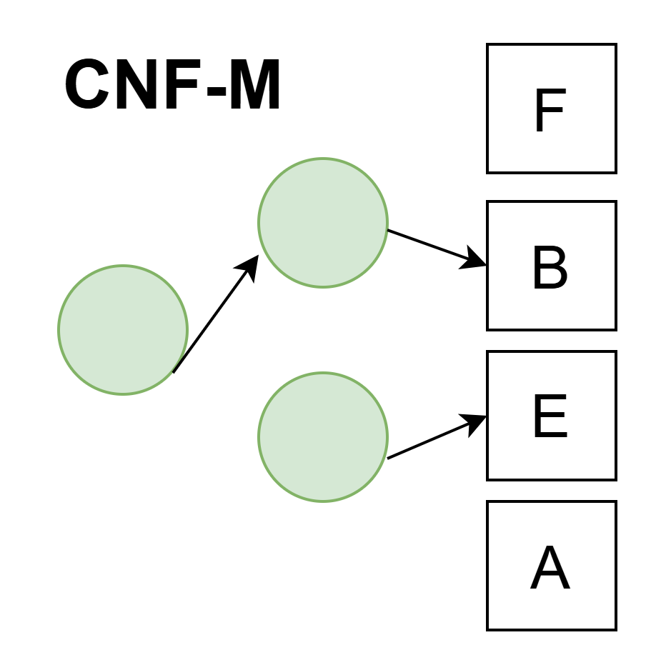
Block Replacement Algorithms
5) Consider a 4-way associative cache that can be operated in one among the two modes at a time. In mode-1 it uses pseudo LRU block replacement policy and in mode-2 it uses Last In First Out block replacement policy. Assume all the cache blocks are initially empty and filling up of empty blocks in a given cache set happens from way 0 to way-3.
All the cache blocks are initially empty and filling up of empty blocks in a given cache set happens from way 0 to way-3. pseudo LRU block replacement policy Block List that maps to set n. A, B, C, D, A, B, E, F, A, B, F, C, D, A.

Slide 26
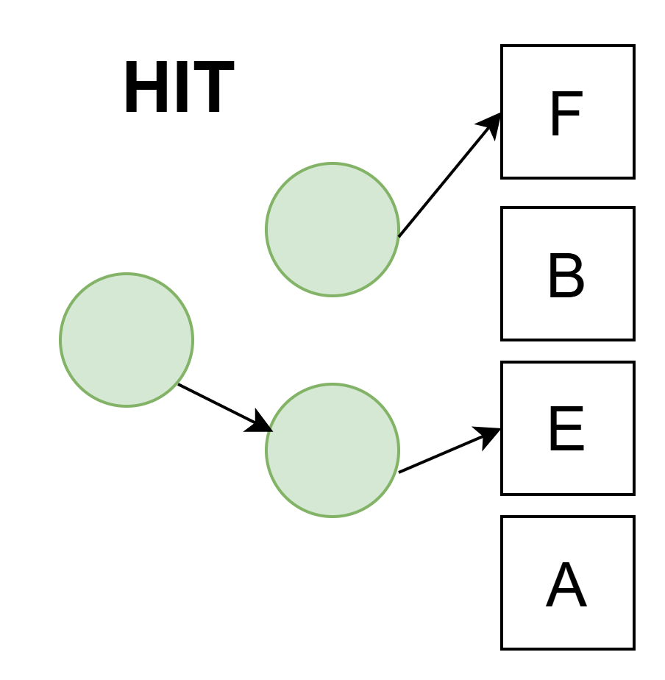
Block Replacement Algorithms
5) Consider a 4-way associative cache that can be operated in one among the two modes at a time. In mode-1 it uses pseudo LRU block replacement policy and in mode-2 it uses Last In First Out block replacement policy. Assume all the cache blocks are initially empty and filling up of empty blocks in a given cache set happens from way 0 to way-3.
All the cache blocks are initially empty and filling up of empty blocks in a given cache set happens from way 0 to way-3. pseudo LRU block replacement policy Block List that maps to set n. A, B, C, D, A, B, E, F, A, B, F, C, D, A.

Slide 27

Block Replacement Algorithms
5) Consider a 4-way associative cache that can be operated in one among the two modes at a time. In mode-1 it uses pseudo LRU block replacement policy and in mode-2 it uses Last In First Out block replacement policy. Assume all the cache blocks are initially empty and filling up of empty blocks in a given cache set happens from way 0 to way-3.
All the cache blocks are initially empty and filling up of empty blocks in a given cache set happens from way 0 to way-3. pseudo LRU block replacement policy Block List that maps to set n. A, B, C, D, A, B, E, F, A, B, F, C, D, A.

Slide 28

Block Replacement Algorithms
5) Consider a 4-way associative cache that can be operated in one among the two modes at a time. In mode-1 it uses pseudo LRU block replacement policy and in mode-2 it uses Last In First Out block replacement policy. Assume all the cache blocks are initially empty and filling up of empty blocks in a given cache set happens from way 0 to way-3.
All the cache blocks are initially empty and filling up of empty blocks in a given cache set happens from way 0 to way-3. pseudo LRU block replacement policy Block List that maps to set n. A, B, C, D, A, B, E, F, A, B, F, C, D, A.

Slide 29

Block Replacement Algorithms
5) Consider a 4-way associative cache that can be operated in one among the two modes at a time. In mode-1 it uses pseudo LRU block replacement policy and in mode-2 it uses Last In First Out block replacement policy. Assume all the cache blocks are initially empty and filling up of empty blocks in a given cache set happens from way 0 to way-3.
All the cache blocks are initially empty and filling up of empty blocks in a given cache set happens from way 0 to way-3. pseudo LRU block replacement policy Block List that maps to set n. A, B, C, D, A, B, E, F, A, B, F, C, D, A.

Slide 30

Block Replacement Algorithms
5) Consider a 4-way associative cache that can be operated in one among the two modes at a time. In mode-1 it uses pseudo LRU block replacement policy and in mode-2 it uses Last In First Out block replacement policy. Assume all the cache blocks are initially empty and filling up of empty blocks in a given cache set happens from way 0 to way-3.
All the cache blocks are initially empty and filling up of empty blocks in a given cache set happens from way 0 to way-3. pseudo LRU block replacement policy Block List that maps to set n. A, B, C, D, A, B, E, F, A, B, F, C, D, A.
Total 14 access
6 CMP-Miss
3 CNF-Miss
5 HITS

Slide 31
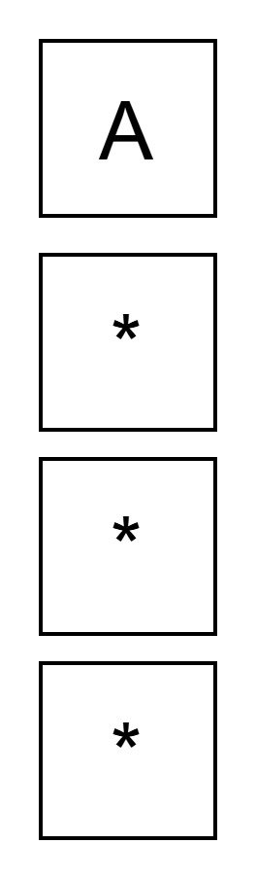
Block Replacement Algorithms
5) Consider a 4-way associative cache that can be operated in one among the two modes at a time. In mode-1 it uses pseudo LRU block replacement policy and in mode-2 it uses Last In First Out block replacement policy. Assume all the cache blocks are initially empty and filling up of empty blocks in a given cache set happens from way 0 to way-3.
All the cache blocks are initially empty and filling up of empty blocks in a given cache set happens from way 0 to way-3. LIFO block replacement policy Block List that maps to set n. A, B, C, D, A, B, E, F, A, B, F, C, D, A.

Slide 32
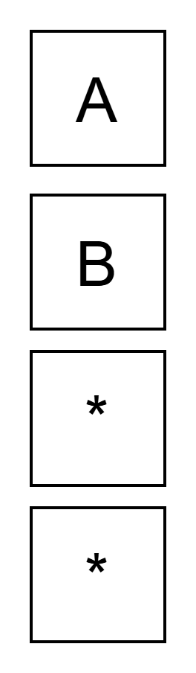
Block Replacement Algorithms
5) Consider a 4-way associative cache that can be operated in one among the two modes at a time. In mode-1 it uses pseudo LRU block replacement policy and in mode-2 it uses Last In First Out block replacement policy. Assume all the cache blocks are initially empty and filling up of empty blocks in a given cache set happens from way 0 to way-3.
All the cache blocks are initially empty and filling up of empty blocks in a given cache set happens from way 0 to way-3. LIFO block replacement policy Block List that maps to set n. A, B, C, D, A, B, E, F, A, B, F, C, D, A.

Slide 33
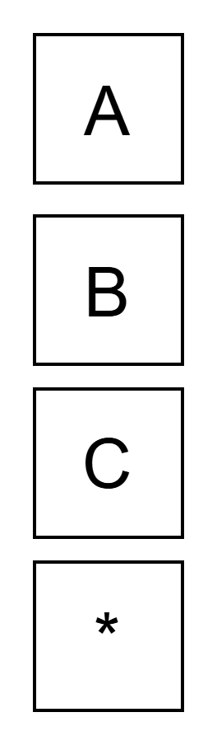
Block Replacement Algorithms
5) Consider a 4-way associative cache that can be operated in one among the two modes at a time. In mode-1 it uses pseudo LRU block replacement policy and in mode-2 it uses Last In First Out block replacement policy. Assume all the cache blocks are initially empty and filling up of empty blocks in a given cache set happens from way 0 to way-3.
All the cache blocks are initially empty and filling up of empty blocks in a given cache set happens from way 0 to way-3. LIFO block replacement policy Block List that maps to set n. A, B, C, D, A, B, E, F, A, B, F, C, D, A.

Slide 34
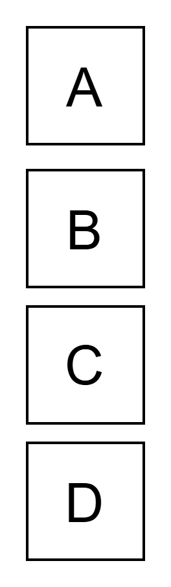
Block Replacement Algorithms
5) Consider a 4-way associative cache that can be operated in one among the two modes at a time. In mode-1 it uses pseudo LRU block replacement policy and in mode-2 it uses Last In First Out block replacement policy. Assume all the cache blocks are initially empty and filling up of empty blocks in a given cache set happens from way 0 to way-3.
All the cache blocks are initially empty and filling up of empty blocks in a given cache set happens from way 0 to way-3. LIFO block replacement policy Block List that maps to set n. A, B, C, D, A, B, E, F, A, B, F, C, D, A.

Slide 35
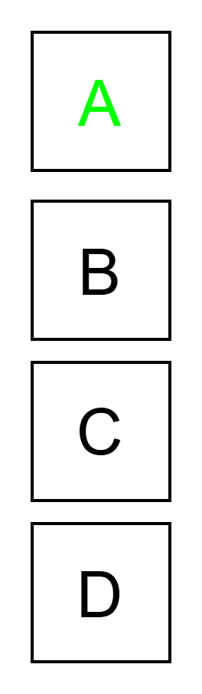
Block Replacement Algorithms
5) Consider a 4-way associative cache that can be operated in one among the two modes at a time. In mode-1 it uses pseudo LRU block replacement policy and in mode-2 it uses Last In First Out block replacement policy. Assume all the cache blocks are initially empty and filling up of empty blocks in a given cache set happens from way 0 to way-3.
All the cache blocks are initially empty and filling up of empty blocks in a given cache set happens from way 0 to way-3. LIFO block replacement policy Block List that maps to set n. A, B, C, D, A, B, E, F, A, B, F, C, D, A.

Slide 36
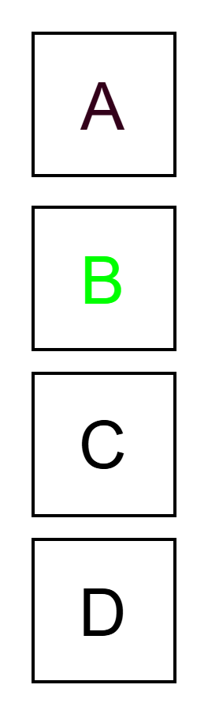
Block Replacement Algorithms
5) Consider a 4-way associative cache that can be operated in one among the two modes at a time. In mode-1 it uses pseudo LRU block replacement policy and in mode-2 it uses Last In First Out block replacement policy. Assume all the cache blocks are initially empty and filling up of empty blocks in a given cache set happens from way 0 to way-3.
All the cache blocks are initially empty and filling up of empty blocks in a given cache set happens from way 0 to way-3. LIFO block replacement policy Block List that maps to set n. A, B, C, D, A, B, E, F, A, B, F, C, D, A.

Slide 37
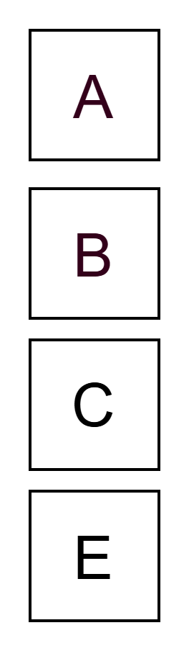
Block Replacement Algorithms
5) Consider a 4-way associative cache that can be operated in one among the two modes at a time. In mode-1 it uses pseudo LRU block replacement policy and in mode-2 it uses Last In First Out block replacement policy. Assume all the cache blocks are initially empty and filling up of empty blocks in a given cache set happens from way 0 to way-3.
All the cache blocks are initially empty and filling up of empty blocks in a given cache set happens from way 0 to way-3. LIFO block replacement policy Block List that maps to set n. A, B, C, D, A, B, E, F, A, B, F, C, D, A.

Slide 38
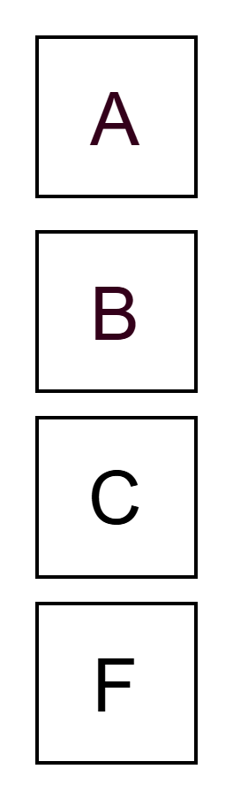
Block Replacement Algorithms
5) Consider a 4-way associative cache that can be operated in one among the two modes at a time. In mode-1 it uses pseudo LRU block replacement policy and in mode-2 it uses Last In First Out block replacement policy. Assume all the cache blocks are initially empty and filling up of empty blocks in a given cache set happens from way 0 to way-3.
All the cache blocks are initially empty and filling up of empty blocks in a given cache set happens from way 0 to way-3. LIFO block replacement policy Block List that maps to set n. A, B, C, D, A, B, E, F, A, B, F, C, D, A.

Slide 39
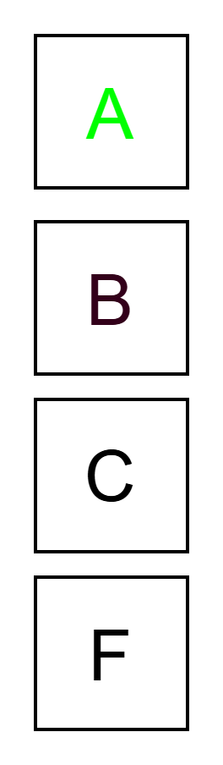
Block Replacement Algorithms
5) Consider a 4-way associative cache that can be operated in one among the two modes at a time. In mode-1 it uses pseudo LRU block replacement policy and in mode-2 it uses Last In First Out block replacement policy. Assume all the cache blocks are initially empty and filling up of empty blocks in a given cache set happens from way 0 to way-3.
All the cache blocks are initially empty and filling up of empty blocks in a given cache set happens from way 0 to way-3. LIFO block replacement policy Block List that maps to set n. A, B, C, D, A, B, E, F, A, B, F, C, D, A.

Slide 40
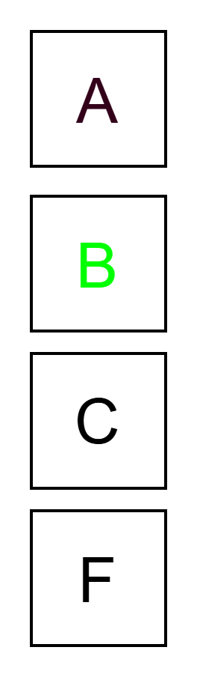
Block Replacement Algorithms
5) Consider a 4-way associative cache that can be operated in one among the two modes at a time. In mode-1 it uses pseudo LRU block replacement policy and in mode-2 it uses Last In First Out block replacement policy. Assume all the cache blocks are initially empty and filling up of empty blocks in a given cache set happens from way 0 to way-3.
All the cache blocks are initially empty and filling up of empty blocks in a given cache set happens from way 0 to way-3. LIFO block replacement policy Block List that maps to set n. A, B, C, D, A, B, E, F, A, B, F, C, D, A.

Slide 41
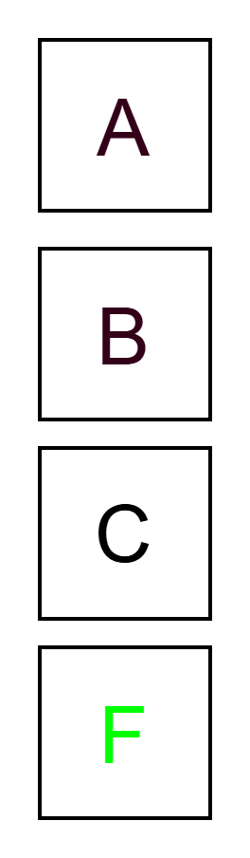
Block Replacement Algorithms
5) Consider a 4-way associative cache that can be operated in one among the two modes at a time. In mode-1 it uses pseudo LRU block replacement policy and in mode-2 it uses Last In First Out block replacement policy. Assume all the cache blocks are initially empty and filling up of empty blocks in a given cache set happens from way 0 to way-3.
All the cache blocks are initially empty and filling up of empty blocks in a given cache set happens from way 0 to way-3. LIFO block replacement policy Block List that maps to set n. A, B, C, D, A, B, E, F, A, B, F, C, D, A.

Slide 42
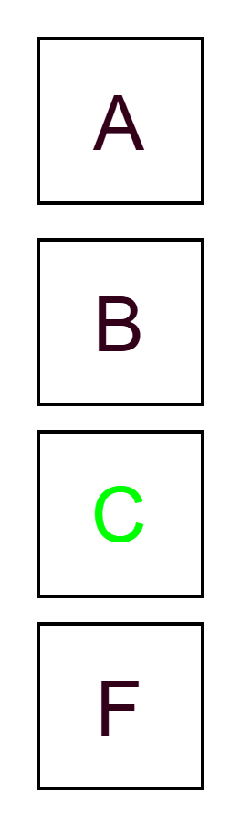
Block Replacement Algorithms
5) Consider a 4-way associative cache that can be operated in one among the two modes at a time. In mode-1 it uses pseudo LRU block replacement policy and in mode-2 it uses Last In First Out block replacement policy. Assume all the cache blocks are initially empty and filling up of empty blocks in a given cache set happens from way 0 to way-3.
All the cache blocks are initially empty and filling up of empty blocks in a given cache set happens from way 0 to way-3. LIFO block replacement policy Block List that maps to set n. A, B, C, D, A, B, E, F, A, B, F, C, D, A.

Slide 43
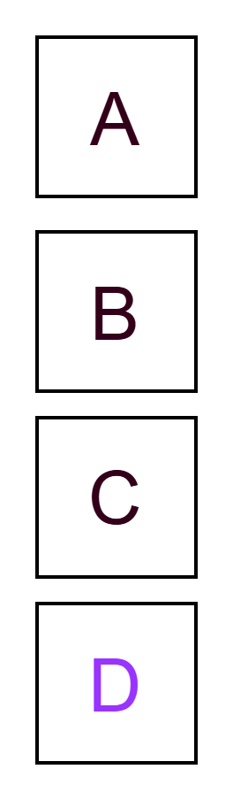
Block Replacement Algorithms
5) Consider a 4-way associative cache that can be operated in one among the two modes at a time. In mode-1 it uses pseudo LRU block replacement policy and in mode-2 it uses Last In First Out block replacement policy. Assume all the cache blocks are initially empty and filling up of empty blocks in a given cache set happens from way 0 to way-3.
All the cache blocks are initially empty and filling up of empty blocks in a given cache set happens from way 0 to way-3. LIFO block replacement policy Block List that maps to set n. A, B, C, D, A, B, E, F, A, B, F, C, D, A.

Slide 44
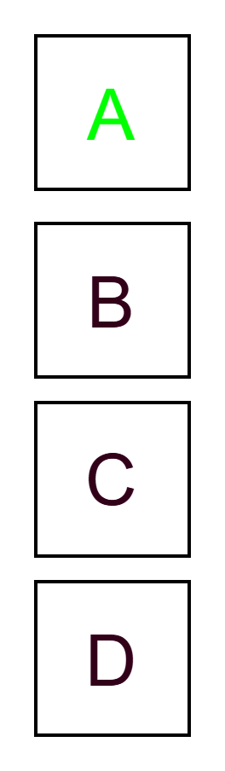
Block Replacement Algorithms
5) Consider a 4-way associative cache that can be operated in one among the two modes at a time. In mode-1 it uses pseudo LRU block replacement policy and in mode-2 it uses Last In First Out block replacement policy. Assume all the cache blocks are initially empty and filling up of empty blocks in a given cache set happens from way 0 to way-3.
All the cache blocks are initially empty and filling up of empty blocks in a given cache set happens from way 0 to way-3. LIFO block replacement policy Block List that maps to set n. A, B, C, D, A, B, E, F, A, B, F, C, D, A.
Total 14 access
6 CMP-Miss
1 CNF-Miss
7 HITS

Slide 45
Cache Mapping
6) Consider a computer system based on 32 bit processor with 8KB direct mapped on-chip I-cache and 16KB 2-way set associative on-chip D-cache. The off-chip unified cache is 128 KB 4-way set associative. Block size for on-chip cache is 8 words and off-chip cache is 16 words. Four fixed length instruction starting at main memory word address 22 (in decimal) are executed. These instructions refer to data at main memory word address 260, 261 and 275 (all in decimal). Assuming caches are initially empty; indicate the non empty blocks on all the caches after execution of the instruction.

Slide 46
Cache Mapping
6) Consider a computer system based on 32 bit processor with 8KB direct mapped on-chip I-cache and 16KB 2-way set associative on-chip D-cache. The off-chip unified cache is 128 KB 4-way set associative. Block size for on-chip cache is 8 words and off-chip cache is 16 words. Four fixed length instruction starting at main memory word address 22 (in decimal) are executed. These instructions refer to data at main memory word address 260, 261 and 275 (all in decimal). Assuming caches are initially empty; indicate the non empty blocks on all the caches after execution of the instruction.
Instruction Words 22,23,24,25
Data 260,261,275

Slide 47
Cache Mapping
6) Consider a computer system based on 32 bit processor with 8KB direct mapped on-chip I-cache and 16KB 2-way set associative on-chip D-cache. The off-chip unified cache is 128 KB 4-way set associative. Block size for on-chip cache is 8 words and off-chip cache is 16 words. Four fixed length instruction starting at main memory word address 22 (in decimal) are executed. These instructions refer to data at main memory word address 260, 261 and 275 (all in decimal). Assuming caches are initially empty; indicate the non empty blocks on all the caches after execution of the instruction.
Instruction Words 22,23,24,25
Data 260,261,275
Location in MM @ L2 block size → 22/16, 23/16, 24/16, 25/16=B1
Location in MM @ L2 block size → 260/16, 261/16=B16, 275/16=B17
# sets L2 = Cache Size/(Block Size x A) = 2¹⁷/(2⁴·2²x2²) = 2⁹ = 512 sets
B1%512 -> S1
B16%512 -> S16
B17%512 -> S17
One block of sets S1 S16, S17 WILL BE NON EMPTY

Slide 48
Cache Mapping
6) Consider a computer system based on 32 bit processor with 8KB direct mapped on-chip I-cache and 16KB 2-way set associative on-chip D-cache. The off-chip unified cache is 128 KB 4-way set associative. Block size for on-chip cache is 8 words and off-chip cache is 16 words. Four fixed length instruction starting at main memory word address 22 (in decimal) are executed. These instructions refer to data at main memory word address 260, 261 and 275 (all in decimal). Assuming caches are initially empty; indicate the non empty blocks on all the caches after execution of the instruction.
Instruction Words 22,23,24,25
Data 260,261,275
Location in MM @ L2 block size → 22/16, 23/16, 24/16, 25/16=B1
Location in MM @ L2 block size → 260/16, 261/16=B16, 275/16=B17
# sets L2 = Cache Size/(Block Size x A) = 2¹⁷/(2⁴·2²x2²) = 2⁹ = 512 sets
B1%512 -> S1
B16%512 -> S16
B17%512 -> S17
One block of sets S1 S16, S17 WILL BE NON EMPTY

Slide 49
Cache Mapping
6) Consider a computer system based on 32 bit processor with 8KB direct mapped on-chip I-cache and 16KB 2-way set associative on-chip D-cache. The off-chip unified cache is 128 KB 4-way set associative. Block size for on-chip cache is 8 words and off-chip cache is 16 words. Four fixed length instruction starting at main memory word address 22 (in decimal) are executed. These instructions refer to data at main memory word address 260, 261 and 275 (all in decimal). Assuming caches are initially empty; indicate the non empty blocks on all the caches after execution of the instruction.
Instruction Words 22,23,24,25
Data 260,261,275
Location in MM @ L1-I block size → 22/8, 23/8 = B2
Location in MM @ L1-I block size → 24/8, 25/8 = B3
Location in MM @ L1-D block size → 260/8, 261/8=B32, 275/8=B34
# sets L1-I = Cache Size/(Block Size x A) = 2¹³/(2³·2²x1) = 2⁸ = 256 sets
B2%256 -> S2 (22,23)
B3%256 -> S3 (24,25)
Sets S2 & S3 of L1-I cache WILL BE NON EMPTY

Slide 50
Cache Mapping
6) Consider a computer system based on 32 bit processor with 8KB direct mapped on-chip I-cache and 16KB 2-way set associative on-chip D-cache. The off-chip unified cache is 128 KB 4-way set associative. Block size for on-chip cache is 8 words and off-chip cache is 16 words. Four fixed length instruction starting at main memory word address 22 (in decimal) are executed. These instructions refer to data at main memory word address 260, 261 and 275 (all in decimal). Assuming caches are initially empty; indicate the non empty blocks on all the caches after execution of the instruction.
Instruction Words 22,23,24,25
Data 260,261,275
Location in MM @ L1-I block size → 22/8, 23/8 = B2
Location in MM @ L1-I block size → 24/8, 25/8 = B3
Location in MM @ L1-D block size → 260/8, 261/8=B32, 275/8=B34
# sets L1-D = Cache Size/(Block Size x A) = 2¹⁴/(2³·2²x2¹) = 2⁸ = 256 sets
B32%256 -> S32
B34%256 -> S34
One block of Sets S32,S34 of L1-D cache WILL BE NON EMPTY

Slide 51
Write Policy Interaction with Cache Misses
7) A system uses write-through cache with no-write-allocate policy. Another system uses write-back cache with write-allocate policy. Both systems write to a cache line not currently in the cache.
Which statement is correct regarding these two systems?
A) The write-through system writes to memory and allocates a cache line; the write-back system updates only memory
B) The write-through system writes only to memory without allocating a cache line; the write-back system allocates a cache line and writes to it
C) Both systems will have identical behavior in terms of memory bus traffic
D) The write-back system will generate more memory traffic for this single write operation

Slide 52
Write Policy Interaction with Cache Misses
7) A system uses write-through cache with no-write-allocate policy. Another system uses write-back cache with write-allocate policy. Both systems write to a cache line not currently in the cache.
Answer: B) The write-through system writes only to memory without allocating a cache line; the write-back system allocates a cache line and writes to it
Explanation:
Write-through + no-write-allocate: Write misses bypass the cache, directly updating main memory without bringing data into cache
Write-back + write-allocate: Write misses first allocate a cache line, then the written data is placed in cache (dirty bit set), and later written back when evicted
The write-through system generates immediate memory traffic but keeps the cache clean
The write-back system defers memory traffic but must manage dirty lines
For a single write, write-through generates immediate traffic; write-back might not if the line is overwritten before eviction

Slide 53
Cache Block Size Optimization Trade-off
8) Two cache configurations are compared for a workload with uniform spatial locality but poor temporal locality:
Config X: 32 KB cache, 16-byte blocks, 4-way set-associative
Config Y: 32 KB cache, 64-byte blocks, 4-way set-associative
The workload frequently accesses sequential memory regions but doesn't reuse data within 10 cache blocks. Which statement best describes the performance implication?
A) Config X will always outperform Config Y due to better temporal reuse
B) Config X will have higher miss rate but lower miss penalty than Config Y
C) Config Y will have lower miss rate but higher miss penalty than Config X
D) Config Y will outperform Config X because it reduces misses through larger blocks

Slide 54
Cache Block Size Optimization Trade-off
8) Two cache configurations are compared for a workload with uniform spatial locality but poor temporal locality:
Config X: 32 KB cache, 16-byte blocks, 4-way set-associative
Config Y: 32 KB cache, 64-byte blocks, 4-way set-associative
Answer: D) Since the workload has poor temporal locality (no reuse within 10 blocks), temporal reuse benefits are negligible for both configurations. The dominant performance factor becomes spatial locality.
Larger blocks (64 bytes) in Config Y capture more sequential data in a single cache fetch. When accessing sequential memory regions, Config Y brings in 4× more useful data per miss.
Compulsory misses are reduced: For sequential access patterns, the first access to a new data region causes a miss. With larger blocks, you get more of that sequential region cached, reducing future misses on related sequential data.
Miss penalty relationship: While Config Y has fewer total blocks (512 vs 2,048), the reduced miss rate more than compensates for the slightly larger miss penalty. The miss rate improvement outweighs any latency trade-off.
Hence:
Incorrect: Temporal reuse is poor (10+ block gap), so temporal locality argument doesn't apply
Misleading: Config X does have higher miss rate, but this is the disadvantage, not advantage
Inverted: Config Y actually has lower miss rate due to larger blocks capturing sequential data
Correct: Larger blocks directly reduce misses in sequential access patterns with poor temporal reuse

Slide 55
Three C's of Cache Misses - Identification and Measurement
9) A processor with a 64 KB direct-mapped cache with 32-byte blocks initially runs a program that repeatedly accesses a 100 KB array. After the working set stabilizes (after many iterations), the miss rate becomes 2%. Later, the same program runs on a larger 256 KB direct-mapped cache (same block size), and the new miss rate is 0.8%.
Which type(s) of misses were eliminated by increasing cache size?
A) Only compulsory misses
B) Only capacity misses
C) Conflict misses and capacity misses
D) Only conflict misses

Slide 56
Three C's of Cache Misses - Identification and Measurement
9) A processor with a 64 KB direct-mapped cache with 32-byte blocks initially runs a program that repeatedly accesses a 100 KB array. After the working set stabilizes (after many iterations), the miss rate becomes 2%. Later, the same program runs on a larger 256 KB direct-mapped cache (same block size), and the new miss rate is 0.8%.
Answer: B) Only capacity misses
Explanation:
Compulsory misses cannot be reduced by increasing cache size (they occur on first access to any data)
The initial setup shows 2% miss rate after stabilization, meaning conflict misses have already affected performance
The array (100 KB) is larger than the 64 KB cache, causing capacity misses
After cache size increase to 256 KB (which now fits the 100 KB array), the remaining 0.8% represents compulsory misses (~32 KB / 100 KB ≈ 0.32% in this scenario, but the exact percentage depends on iteration count)
Since we're in direct-mapped cache, conflict misses are still present, so the reduction from 2% to 0.8% primarily shows capacity misses being eliminated

Slide 57
Replacement Policies and Miss Prediction
10) A 4-way set-associative cache uses Pseudo-LRU replacement. A memory access sequence to a single cache set is:
Block A, Block B, Block C, Block D, Block A, Block E, Block F, Block G
Assuming all blocks are initially not in the cache, what will be the state of the cache after this sequence?
A) Blocks {A, B, E, F} with G as the most recent
B) Blocks {E, F, G, and one of A/B/C} with G as most recent
C) Blocks {C, D, E, F}
D) Blocks {E, F, G, A}

Slide 58
Replacement Policies and Miss Prediction
10) A 4-way set-associative cache uses Pseudo-LRU replacement. A memory access sequence to a single cache set is:
Block A, Block B, Block C, Block D, Block A, Block E, Block F, Block G
Answer: D) Blocks {E, F, G, A}
Explanation:
Pseudo-LRU maintains a tree-based replacement policy. Tracing through with a typical 4-way Pseudo-LRU implementation:
A, B, C, D: All four ways filled
Access A: A marked as recently used
Access E: Pseudo-LRU evicts the least recently used block (B)
Access F: Pseudo-LRU evicts C
Access G: Pseudo-LRU evicts D Final state: {A, E, F, G}
The key insight is that Pseudo-LRU doesn't track perfect LRU order but uses a binary tree to approximate it, making it more efficient than true LRU while providing better replacement than FIFO.

